Slide 1
State machine diagram ( PartC )
New watch requirements ( PartC )
Ability to apply translation, rotation and scale operations
Ability to get analogical watch
Digital Watch
press Analogic button
Analogical Watch
press Analogic button
Apply transformation matrix
Decomposed by translation, rotation and scale
Scene
Last created watch

Slide 2
Model class diagram ( PartC )
Scene
-watches[]:array
-watchesIndex:int
-deltaGMT:int
+addWatch(watchesIndex,
deltaGMT)
+removeWatch(watchesIndex)
1
MODEL
contains
n
TwoDigitalNumber
DigitalNumber
WatchModel
- First:DigitalNumber
- Second:DigitalNumber
- Group:ThreeGroup
- Number:int
1
2
-Hours:TwoDigitalNumber
-Minutes:TwoDigitalNumber
-Seconds:TwoDigitalNumber
-deltaHours:int
-deltaMinutes:int
-ampmButtonState:int
-deltaGMT:int
-hoursHandle:geometry
-minutesHandle:geometry
-secondsHandle:geometry
1
3
contains
#Create
+setNumber( number:int )
+getNumber():int
+updateNumber( number:int)
#Init()
+Update( number:int )
contains
WatchButton
-name:string
-positionX:float
-position:float
-positionZ:float
1
n
+Update()
#initNumbers()
#initDots()
#initWatchButtons()
#initWatchFace()
+setWatchFaceColor( color:color )
+increaseHours()
+increaseMinutes()
+initWatchHandles()
contains
#init( name, positionX, position, positionZ )

Slide 3
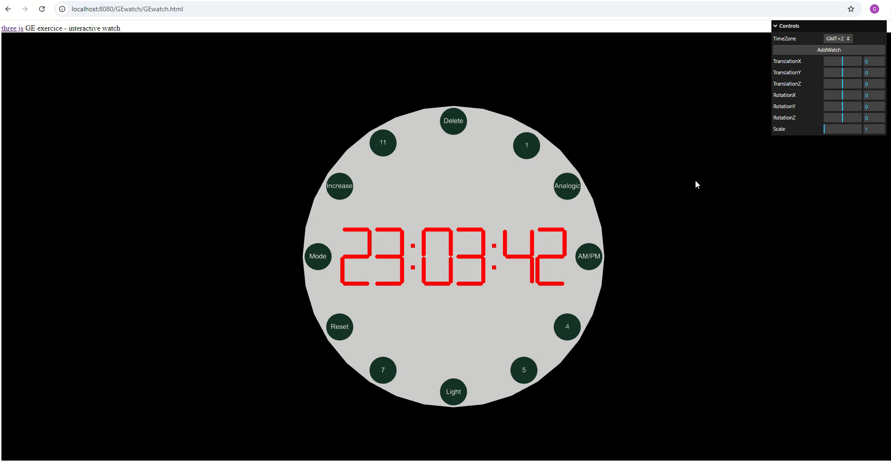
Watch transformation & analogic watch ( PartC )

